Slide 1
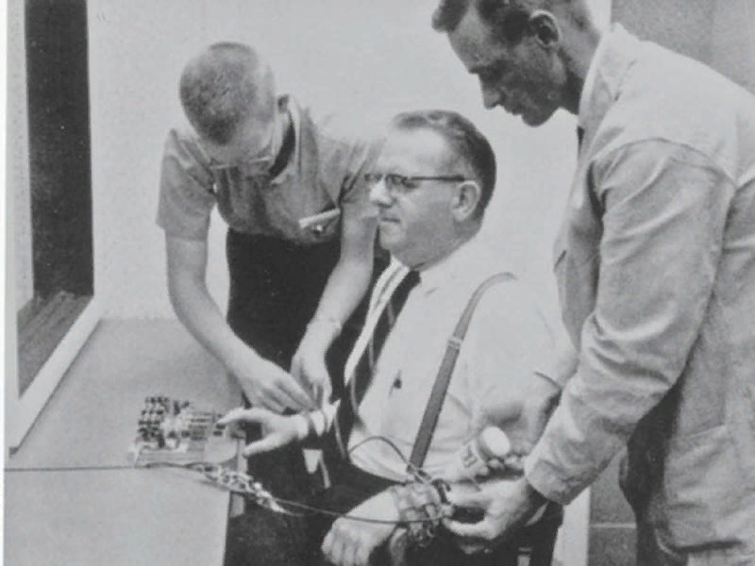
The Milgram experiment and social conformity

Slide 2

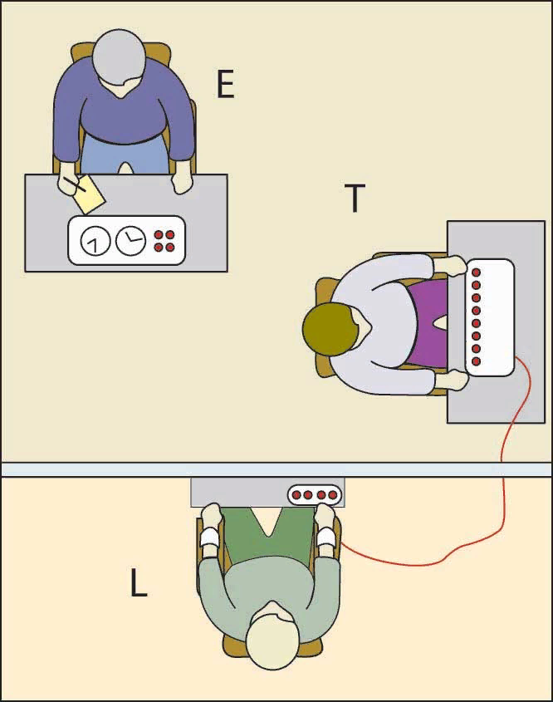

Slide 3

«Please, continue»
«Experiment requires that you continue»
«It is absolutely essential that you continue»
«You have no other choice, you must go on»
These phrases were pronounced in order, starting with the first one, when the "teacher" refused to continue the experiment. If the "teacher" continued to refuse, the next phrase from the list was pronounced. If the "teacher" refused after the 4th phrase, the experiment was interrupted.
If the «teacher» paid attention to the fact that the "student" refuses to continue, the experimenter replied:
- «Whether the learner likes it or not, you must go on until he has learned all the word pairs correctly»
In case the "teacher" asked if the "student" would get any damage, the experimenter answered:
- «Although the shock may be painful, there is no permanent tissue damage»

Slide 5
The fundamental error of attribution - the overestimation of the internal properties of personality when explaining human behavior.
1) The results did not depend much on the authority of the university
2) The gender of the subject did not affect the results
3) People were aware of the danger of electric current for the «student»
4) The subjects were ordinary people. They weren't sadists.

Slide 6
Examples of the action of social conformity and the power of delusion of fundamental attribution error
After a working day at Auschwitz, the commandants of the concentration camps rested listening to Beethoven and Schubert. Many of them had doctorates awarded by various European universities.
Most of the concentration camp punishers were neither Nazis, nor SS members, nor fanatical racists. They were workers, merchants, clerks, artisans, too old to serve in the army, but unable to refuse to obey an order, even if it was an order to kill.

